Slide 1

CSC741 Digital Image Processing Presentation 8
Jessica Gallo & Alex Liew

Slide 2
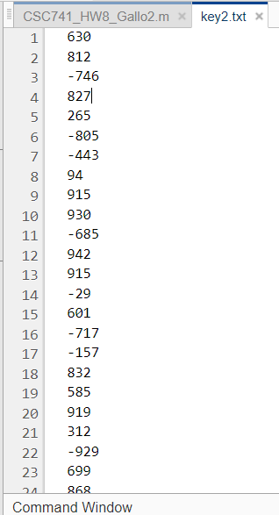
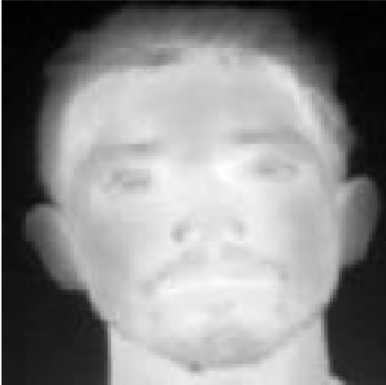
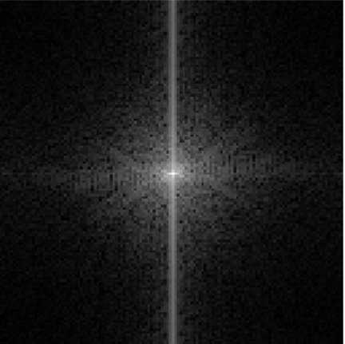


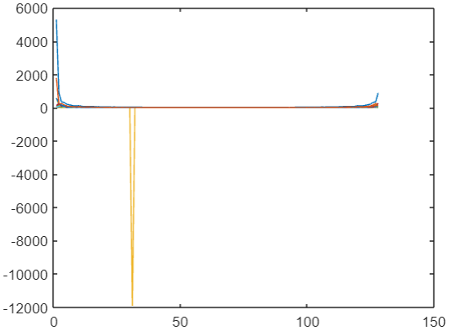


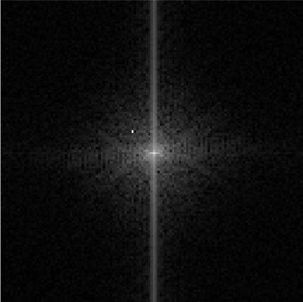
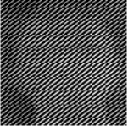
Encryption & Decryption of Thermal Image
Ref: https://www.et.byu.edu/~vps/ME505/AAEM/V5-01.pdf
Magnitude Shift
Inverted Encrypted (Final)
Original
Encrypted
Key file to decrypt
Fourier Transformed Image
Inverted Decrypted Image
Encrypted Image
Use key to get random shifts
Data lose of Magnitude
Notes:
Randomly shifts data up, down, left and right and keeps that information in the key file.

Slide 3
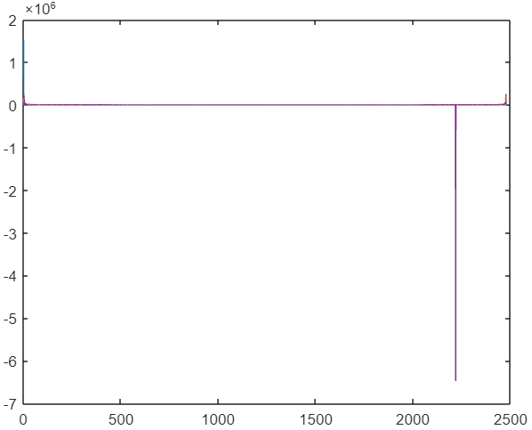
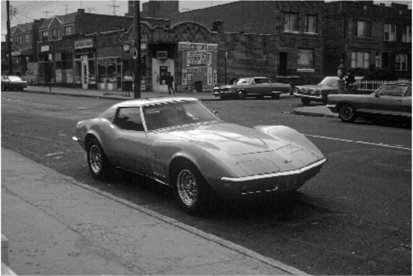




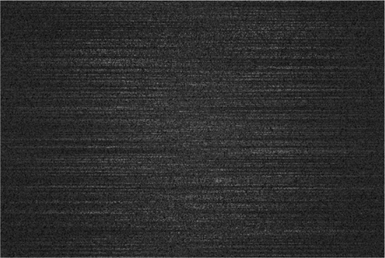
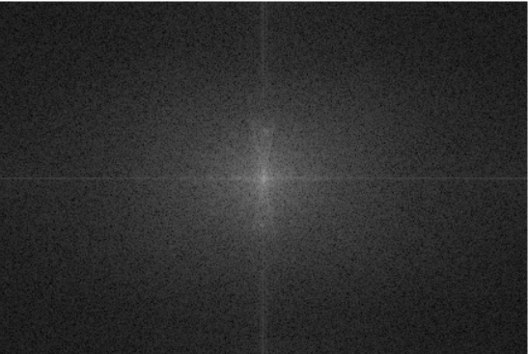
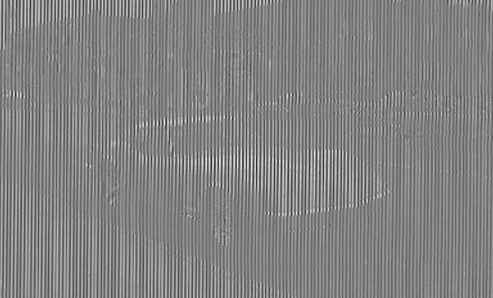
Encryption & Decryption of Regular Image

